Slide 1
DEFINITION OF PSYCHOLOGY
What do psychologists study?
  Psychology
    the systematic, scientific study of behaviors and mental processes
  Behaviors
    observable actions or responses in both humans and animals
  Mental processes
    not directly observable; refer to a wide range of complex mental processes, such as thinking, imagining, studying, and dreaming

Slide 2
GOALS OF PSYCHOLOGY
Describe
  First goal of psychology is to describe the different ways that organisms behave
Explain
  Second goal is to explain the cause of behavior
Predict
  Third goal is to predict how organisms will behave in certain situations
Control
  Fourth goal is to control an organism’s behavior

Slide 3
ANSWERING QUESTIONS
How do psychologists answer questions?
  8 Approaches to understanding behavior include
    biological
    cognitive
    behavioral
    psychoanalytic
    humanistic
    sociocultural
    evolutionary
    biopsychosocial

Slide 4
Biological approach
  Focuses on how our genes, hormones, and nervous system interact with our environments to influence learning, personality, memory, motivation, emotions, and other traits and abilities
  Example 1: test anxiety
    Biological responses to test anxiety include increased heart rate, dry mouth, and sweaty palms
  Example: autism
    Social problems associated with autism may be linked to less activity in mirror neurons, cells associated with human experience of empathy

Slide 5
Biological approach (continued)
  Psychologists using the biological approach are collaborating more and more with specialists in other biological disciplines
  Neuroscience is the interdisciplinary field of scientific study that examines the structure and function of all parts of the nervous system, including the brain, spinal cord, and networks of brain cells

Slide 6
Cognitive approach
  Examines how we process, store, and use information and how this information influences what we attend to, perceive, learn, remember, believe, and feel
  Cognitive neuroscience
    involves taking pictures and identifying the structures and functions of the living brain during performance of a variety of mental or cognitive processes, such as thinking, planning, naming, and recognizing objects

Slide 7
Behavioral approach
  Studies how organisms learn new behaviors or modify existing ones, depending on whether events in their environments reward or punish these behaviors
  Some behaviorists, such as Albert Bandura, disagree with strict behaviorism
  Formulated a theory that includes mental or cognitive processes in addition to observable behaviors

Slide 8
Social cognitive approach
  Behaviors are influenced not only by environmental events and reinforcers but also by observation, imitation, and thought processes

Slide 9
Psychoanalytic approach
  Based on the belief that childhood experiences greatly influence the development of later personality traits and psychological problems
  Stresses the influence of unconscious fears, desires, and motivations on thoughts, behaviors, and the development of personality traits and psychological problems later in life

Slide 10
Humanistic approach
  Emphasizes that each individual has great freedom in directing his or her future, a large capacity for personal growth, a considerable amount of intrinsic worth, and enormous potential for self-fulfillment
  Because of its emphasis on free-will and lack of experimental methods, many behaviorists regard the humanistic approach as more of a philosophy of life than a science of human behavior
  Positive psychology is the scientific study of optimal human functioning, focusing on the strength and virtues that enable individuals and communities to survive

Slide 11
Sociocultural approach
  Studies the influence of social and cultural factors on psychological and behavioral functioning
  Differences in how countries diagnose autism: US
    symptoms first described 70 years ago
    first thought to be caused by environmental factors (cold parents)
    researchers believe the probable causes of autism include environmental and genetic factors
    between 1 and 1.5 million Americans with autism
    diagnosis begins at two-to-three years of age

Slide 12
Sociocultural approach (cont’d)
  Differences in how countries diagnose autism: South Korea
      number of people with autism is unknown
      once a terrible stigma; children with autism often kept home (hidden) from public
      doctors in South Korea usually diagnose (what would be considered autism in US) as reactive attachment disorder, or “lack of love”
      less stigmatizing than a genetic disorder as parents believe they can provide more love
      result is that children don’t receive the treatment they need
      in past few years, perceptions have changed: some children with autism going to school and out in public

Slide 13
Evolutionary approach
  Studies how evolutionary ideas, such as adaptation and natural selection, explain human behaviors and mental processes
Biopsychosocial approach
  Studies how biological, psychological, and social factors influence human development

Slide 14
How did psychology begin?
  Structuralism: elements of the mind
  Functionalism: functions of the mind
  Gestalt approach: sensations versus perceptions
  Behaviorism: observable behaviors

Slide 15
HISTORICAL APPROACHES (CONT’D)
Structuralism
  Wilhelm Wundt (1832-1920)
  Studied the most basic elements, primarily sensations and perceptions, that make up our conscious mental experiences
  Introspection
    method of exploring conscious mental processes by asking subjects to look inward and report their sensations

Slide 16
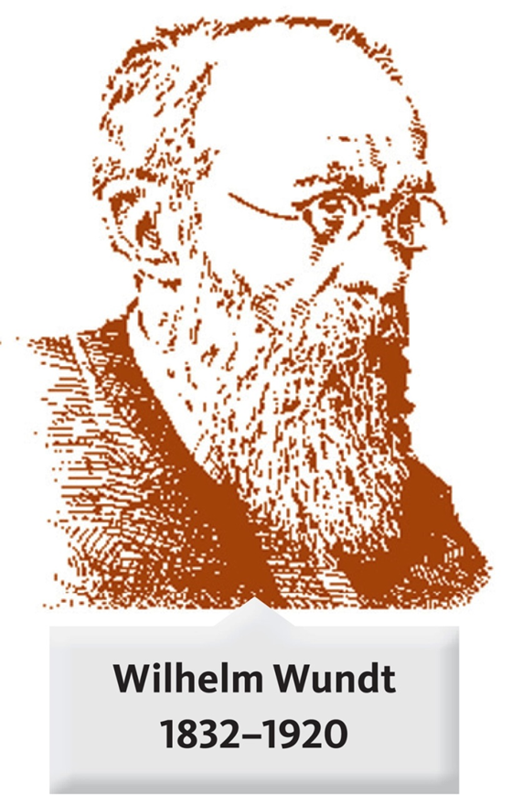
HISTORICAL APPROACHES
Functionalism
  William James (1842-1910)
  Studied the function rather than
  the structure of consciousness
  Was interested in how our minds
  adapt to our changing environment

Slide 17
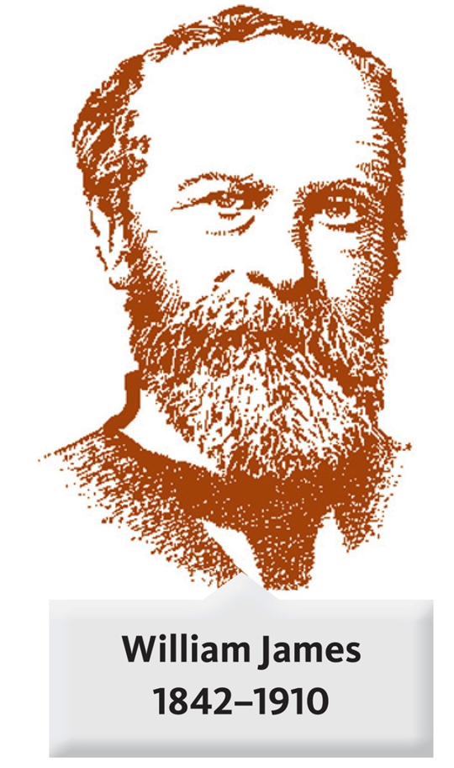
HISTORICAL APPROACHES
Gestalt approach
  Max Wertheimer, Wolfgang Kohler, and Kurt Koffka
  Emphasized that perception is more than the sum of its parts and studied how sensations are assembled into meaningful perceptual experiences

Slide 18
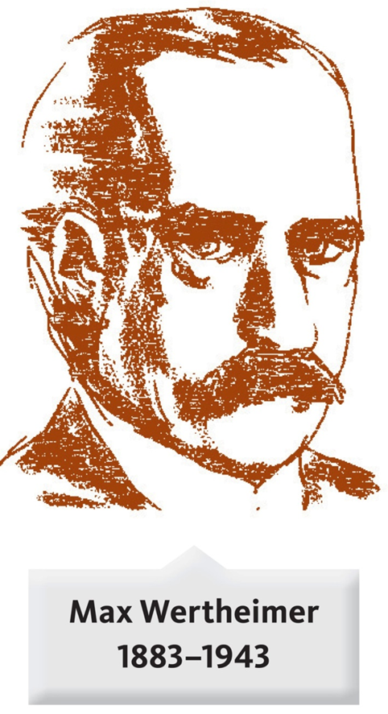
HISTORICAL APPROACHES
Behaviorism
  Emphasized the objective, scientific analysis of observable behaviors
  John Watson; 1913, “Psychology as a Behaviorist Views It”
  Psychology should be considered an objective, experimental science
  Goal: the analysis of observable behaviors and the prediction and control of those behaviors

Slide 19
HISTORICAL APPROACHES (CONT’D)
Behaviorism
  1920s to 1960s; behaviorism was the dominant force in American psychology
  Due to work of B.F. Skinner and other behaviorists
  Expanded Watson’s ideas in modern-day behavioral approach
  1970s to present; behaviorism challenged by cognitive approach (now surpasses behaviorism)

Slide 20
CAREERS IN PSYCHOLOGY
Psychologist versus psychiatrist
  Psychologists have completed four to five years of postgraduate education and have obtained a PhD, PsyD, or EdD in psychology
  Clinical psychologists have a PhD, PsyD, or EdD, specialized in a clinical subarea, and spent an additional year in a supervised therapy setting to gain experience in diagnosing and treating a wide range of abnormal behaviors

Slide 21
CAREERS IN PSYCHOLOGY (CONT’D)
Psychologist versus psychiatrist
  Counseling psychologists provide similar service to those of clinical psychologists, but usually work with different problems (e.g., marriage, family, career counseling)
  Until recently, no psychologists in the US have been able to prescribe drugs
  Now, psychologists in New Mexico and Louisiana (who have completed special medical training) can prescribe drugs like psychiatrists

Slide 22
CAREERS IN PSYCHOLOGY (CONT’D)
Psychologist versus psychiatrist
  Psychiatrists are medical doctors (MDs or DOs) who have spent several years in clinical training, which includes diagnosing possible physical and neurological causes of abnormal behaviors and treating these behaviors, often with prescription drugs

Slide 23
CAREERS IN PSYCHOLOGY (CONT’D)
Many career settings
  49% of psychologists work as clinical or counseling psychologists in private practice or therapy settings
  28% work in college/university settings
  13% work in a variety of other kinds of jobs and career settings
  6% work in industrial settings
  4% work in secondary schools and other settings

Slide 24
RESEARCH AREAS
Areas of specialization
  Clinical and counseling psychology
  Social
  Developmental
  Experimental
  Biological
  Cognitive
  Psychometrics
  Industrial/organizational

Slide 25
RESEARCH AREAS (CONT’D)
Areas of specialization
  Clinical and counseling psychology
    includes the assessment and treatment of people with psychological problems, such as grief, anxiety, or stress
  Social psychology
    involves the study of social interactions, stereotypes, prejudices, attitudes, conformity, group behaviors, and aggression

Slide 26
RESEARCH AREAS (CONT’D)
Areas of specialization
  Developmental psychology
    examines moral, social, emotional, and cognitive development throughout a person’s entire life
  Experimental psychology
    includes areas of sensation, perception, learning, human performance, motivation, and emotion

Slide 27
